Slide 1
Kubernetes

Slide 2
Agenda
Containers and what we miss in them
Kubernetes (k8s)
Setting up cluster
Deploying microservices

Slide 3
Containers

Slide 4
Containers are wonderful
Isolate application environment.
Container image can be executed on any machine.
Easy to set up many containers together and lower the infrastructure costs.

Slide 5
Containers - what is missed?
What if container dies?
What if machine itself dies?
What if we need to set up complex networking between containers?
How to set up a production environments that contains several physical machines? On which should we deploy the container?

Slide 6
K8s

Slide 7
Kubernetes
Orchestration platform.
Service discovery and load balancing.
Automated rollouts and rollbacks - you can specify the way new containers are delivered.
Self-healing - restarts failed containers, removes and recreates not responding containers.
Secrets management - allow to store and manage sensitive information.

Slide 8
Kubernetes - key benefits
High availability - application will always be up and running.
Scalability - doesn’t matter if application have 1 or 1000 containers, they all will be scaled in case of high load.
Disaster recovery - makes sure that application have the latest data in case of infrastructural issues.

Slide 9
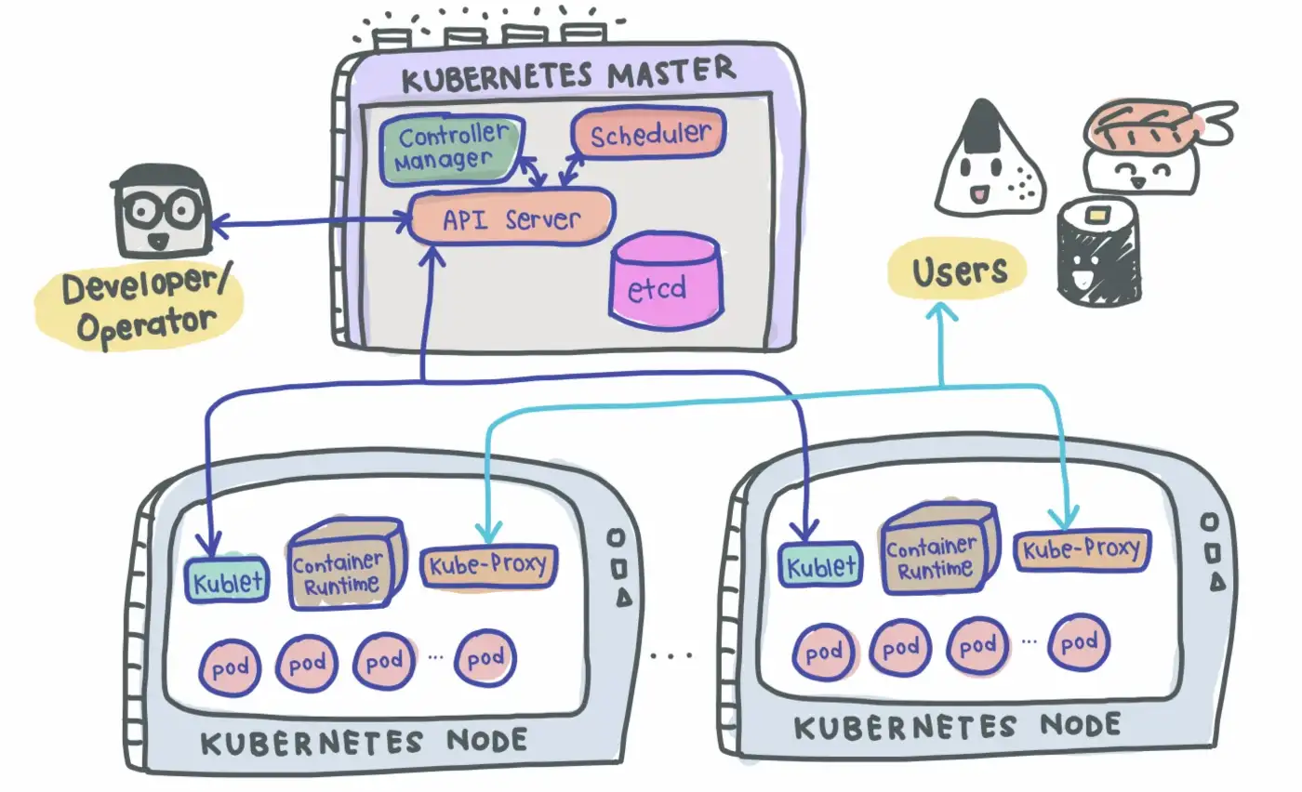
Kubernetes - master/slave system

Slide 10
Kubernetes - Master
API server (kube-apiserver) - main entrypoint for interaction with users (us), also responsible for auth logic.
Scheduler - decides what node to use when starting the pod.
Controller Manager - keeps an eye on pods. If the pod dies - it will ask Scheduler about the node for a new pod + asks Kubelet to do the job.
etcd - brains of the cluster. Keeps all the data and changes from everywhere in the cluster.

Slide 11
Kubernetes - Slave (Worker)
Kubelet - responsible for starting the pods. Works both with node and container.
Container runtime - software for running containers (for example: Docker, containerd, CRI-O).
Kube-proxy - networking between nodes.

Slide 12
Kubernetes - Pod
Smallest part of cluster.
Contains an instance of application.
Abstraction over container.
Each pod has its own IP address - permanent.

Slide 13
Kubernetes - Service
An abstract way to expose a Pod as a network service.
Gives a Pod its permanent IP address - even if the Pod is recreated - the IP address will be the same.
Without this we can lose an access to our backend services.
Routes traffic to Pods, while maintaining a static IP.

Slide 14
Kubernetes - Ingress
Now services allow us to get access to our application by https://sasha.com:5000 - this will lead us to the Pod.
But usually we don’t use ports, we want to set up a proper domain name, and use routes (sasha.com/thoughts - it becomes <pod_ip_address>:5000).
Exposes traffic from outside to services within the cluster.
Ingress-controller is required.

Slide 15
Kubernetes - Ingress Controller
Load balances the incoming traffic to the services inside cluster.
Manages traffic from inside to outside.
Ingress - set of rules.
Ingress Controller - actual implementation of Ingress.
Each cloud provider has its own implementation of Ingress Controller.

Slide 16
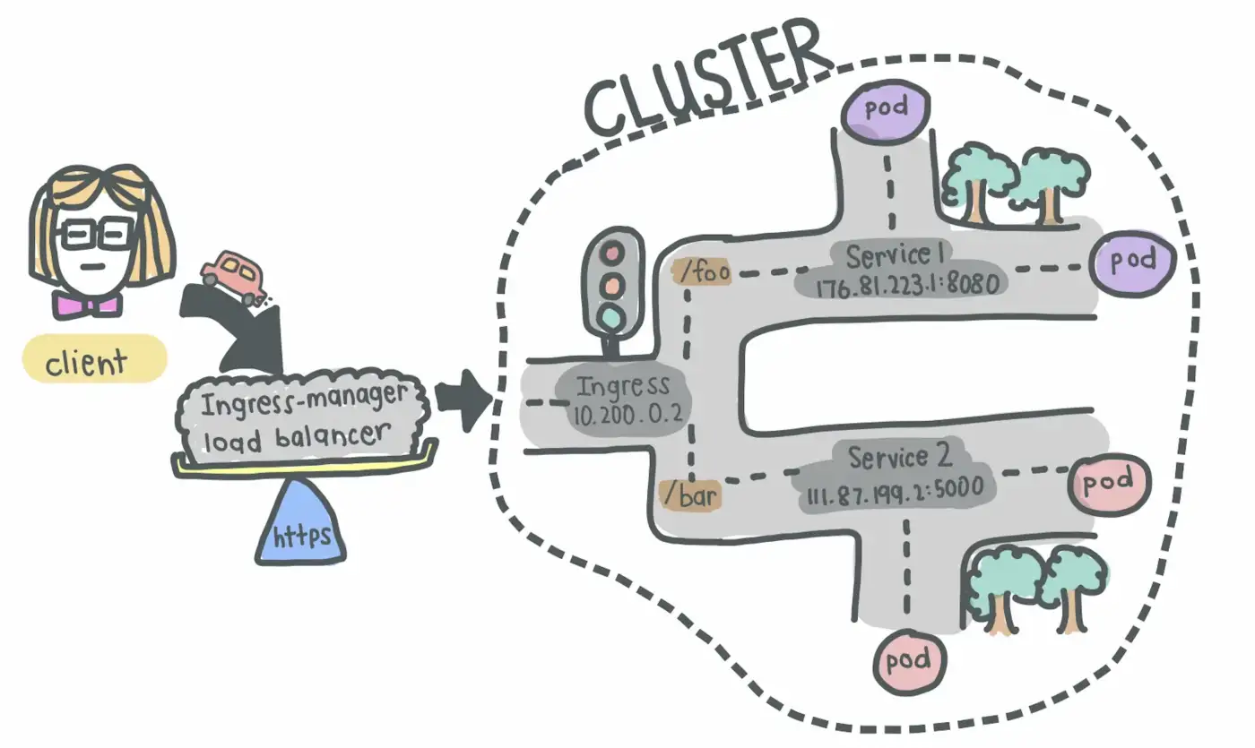

Slide 17
Setting up Cluster

Slide 18
Setting up Cluster
Install Docker.
We will use just pure kubernetes commands.
Enable Kubernetes in Docker (Settings - Kubernetes - Enable Kubernetes).
Set up proper context.
Cluster is created.
kubectl version

Slide 19
Creating our first Pod
Build the docker image.
Create .yml file.
kind: Pod
kubectl create -f <file>.yml
kubectl get pods (kubectl get pods -o wide)
By default, it will look up in remote docker registry, or other setup registry. If you want your local image to be pulled, use imagePullPolicy: Never.

Slide 20
Get logs from Pod
kubectl logs <pod_name>

Slide 21
Accessing our Pod
Port-forwarding - kubectl port-forwarding <pod_name> <host_port>:<pod_port> - not a very good way
Setup Ingress

Slide 22
Setting up Ingress
Setup Ingress Controller - without this nothing will work
https://kubernetes.github.io/ingress-nginx/deploy/#quick-start
Setup Deployment and Service
Setup Ingress

Slide 23
Communication between pods
Kubernetes handles networking inside cluster.
We can use just pod name to access the pod (http://<pod_name>:<port_if_needed>/<path>).

Slide 24
Deployments
Deployment contains the configuration for Pod + settings for Replicas. If number of replicas = 1, the Pod and Deployment types will end up with same result.
Pod configurations defined under template.
template > metadata > labels - id of replica set, should be unique.
selector > matchLabels - which pods are under deployment, should match template > metadata > labels

Slide 25
Services
Distributes traffic to each of the pods replicas.
selector should match template > metadata > labels

Slide 26
Real life
Setting up Ingress.
Setting up Service + Deployment.
If required - Setting up Secrets storage and other things.

Slide 27
Homework, task 1
Implement 2 apis, each for root request (/) should return simple message ‘api1’, ‘api2’. Both should be at port 80 in their pods. Implement ingress which will allow access those apis by localhost/api1, localhost/api2.

Slide 28
Homework, task 2
Set up secrets file, where DB connection string should be stored. API should be able to accept this DB connection string as Environment variable. DB can be set up just in Docker-compose.

Slide 29
Homework, task 3
Set up 3 microservices: BFF, api1, api2 (or other names).
Api1 should be accessible by localhost:<port>/api1. Ingress should route all traffic to BFF, BFF should get the result from api1. Api1 should call Api2 to get some result. Api2 should randomly return 500 errors. Set up retry logic for Api1 so we won’t have an errors on Client side (in the browser).

Slide 30
The End

